Slide 1
Chapter 4
Local Search Algorithms

Slide 2
Local Search Algorithms
In this lecture:
What/Why Local Search
Hill-Climbing Search
Simulated Annealing Search
Genetic Algorithms

Slide 3
In many optimization problems, the path to the goal is irrelevant; the goal state itself is the solution. Eg.
– to reduce cost, as in cost functions
– to reduce conflicts, as in n-queens
The idea: keep a single "current" state, try to improve it according to an objective function.
Local search algorithms:
– Use little memory
– Find reasonable solutions in large infinite spaces

Slide 4
Local search can be used on problems that can be formulated as finding a solution maximizing a criterion among a number of candidate solutions.
• Local search algorithms move from solution to solution in the space of candidate solutions (the search space) until a solution deemed optimal is found or a time bound is elapsed.
• For example, the travelling salesman problem, in which a solution is a cycle containing all nodes of the graph and the target is tominimize the total length of the cycle. i.e. a solution can be a cycle and the criterion to maximize is a combination of the number of nodes and the length of the cycle.
A local search algorithm starts from a candidate solution and then iteratively moves to a neighbor solution.

Slide 5
Local Search
local search in the state space includes evaluating and modifying one or more current states rather than systematically exploring paths from an initial state.
These algorithms are suitable for problems in which all that matters is the solution state, not the path cost to reach it.
The family of local search algorithms includes methods inspired by statistical physics (simulated annealing) and evolutionary biology (genetic algorithms).

Slide 6
Local Search
Local search algorithms operate using a single current node (rather than multiple paths) and generally move only to neighbors of that node. Typically, the paths followed by the search are not retained. Although local search algorithms are not systematic, they have two key advantages:
(1) they use very little memory—usually a constant amount; and
(2) they can often find reasonable solutions in large or infinite (continuous) state spaces for which systematic algorithms are unsuitable.

Slide 7
In addition to finding goals, local search algorithms are useful for solving pure optimization problems, in which the aim is to find the best state according to an objective function
Local search algorithms are typically incomplete algorithms, as the search may stop even if the best solution found by the algorithm is not optimal.

Slide 8
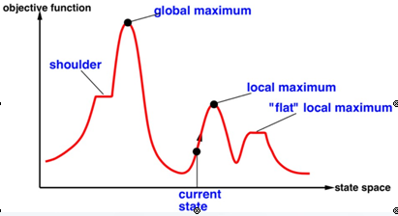
state-space landscape

Slide 9
A landscape has both “location” (defined by the state) and “elevation” (defined by the value of the heuristic cost function or objective function).
If elevation corresponds to cost, then the aim is to find the lowest valley—a global minimum;
if elevation corresponds to an objective function, then the aim is to find the highest peak—a global maximum.
A complete local search algorithm always finds a goal if one exists;
An optimal algorithm always finds a global minimum/maximum.

Slide 10
Hill-Climbing Search
The hill-climbing search algorithm (steepest-ascent version) simply a loop that continually moves in the direction of increasing value—that is, uphill. It terminates when it reaches a “peak” where no neighbor has a higher value.
The algorithm does not maintain a search tree, so the data structure for the current node need only record the state and the value of the objective function.
Hill climbing does not look ahead beyond the immediate neighbors of the current state.

Slide 11
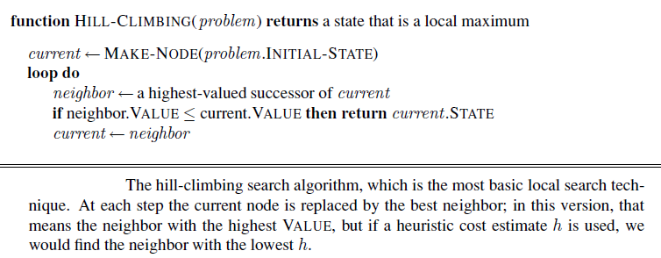

Slide 12
8-queens problem
Local search algorithms typically use a complete-state formulation, where each state has 8 queens on the board, one per column.
The successors of a state are all possible states
generated by moving a single queen to another square in the same column (so each state has 8×7=56 successors).
The heuristic cost function h is the number of pairs of queens that are attacking each other, either directly or indirectly. The global minimum of this function is zero, which occurs only at perfect solutions
Starting from a randomly generated 8-queens state, steepest-ascent hill climbing gets stuck 86% of the time, solving only 14% of problem instances. It works quickly, taking just 4 steps on average when it succeeds and 3 when it gets stuck—not bad for a state space with 8⁸ ≈ 17 million states.
Hill climbing is sometimes called greedy local search because it grabs a good neighbor state without thinking ahead about where to go next.

Slide 13
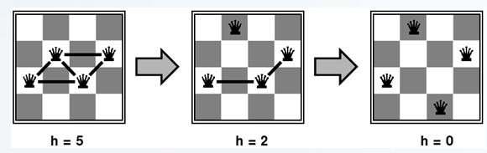
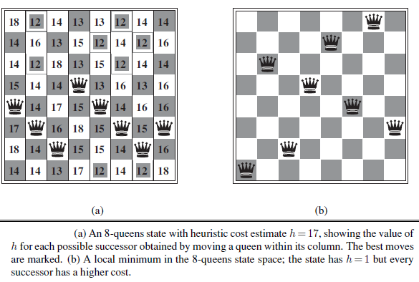
((11,44)(11,55)(1166)(1177)
(4455)(44 66)(4477)(55 66) (55 77) (66 77)(77 68) (7377)
(62 66)(62 68) (66 68)(6273) …

Slide 14
S 20
A(6) b(70) C(100) D(20)
4 5 6 7
4 4 4 4

Slide 15
Hill climbing
It gets stuck for the following reasons:
• Local maxima: a local maximum is a peak that is higher than each of its neighboring states but lower than the global maximum. Hill-climbing algorithms that reach the vicinity of a local maximum will be drawn upward toward the peak but will then be stuck with nowhere else to go.

Slide 16
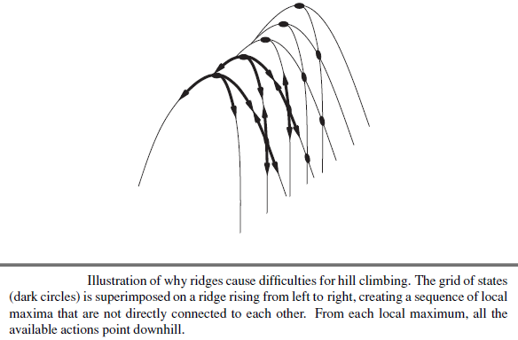
Ridges: a ridge is shown in Figure RIDGE 4.4. Ridges result in a sequence of local maxima that is very difficult for greedy algorithms to navigate.

Slide 17
Plateaux: a plateau is a flat area of the state-space landscape. It can be a flat local maximum, from which no uphill exit exists, or a shoulder, from which progress is possible. A hill-climbing search might get lost on the plateau.
allow a sideways move
If always allow sideways moves when there are no uphill moves, an infinite loop will occur whenever the algorithm reaches a flat local maximum that is not a shoulder. One common solution is to put a limit on the number of consecutive sideways moves allowed.

Slide 18
Variations of Hill Climbing
Stochastic hill climbing chooses at random from among the uphill moves; the probability of selection can vary with the steepness of the uphill move. This usually converges more slowly than steepest ascent, but in somestate landscapes, it finds better solutions.
First-choice hill climbing implements stochastic hill climbing by generating successors randomly until one is generated that is better than the current state. This is a good strategy when a state has many (e.g., thousands) of successors.

Slide 19
Random-restart hill
It climbing adopts the well-known adage, “If at first you don’t succeed, try, try again.” It conducts a series of hill-climbing searches from randomly generated initial states,1 until a goal is found. It is trivially complete with probability approaching 1, because it will eventually generate a goal state as the initial state. If each hill-climbing search has a probability p of success, then the expected number of restarts required is 1/p.
For 8-queens instances with no sideways moves allowed, p ≈ 0.14, so we need roughly 7 iterations to find a goal (6 failures and 1 success). The expected number of steps is the cost of one successful iteration plus (1−p)/p times the cost of failure, or roughly 22 steps in all. When we allow sideways moves, 1/0.94 ≈ 1.06 iterations are needed on average and (1×21)+(0.06/0.94)×64 ≈ 25 steps.
For 8-queens, then, random-restart hill climbing is very effective indeed. Even for three million queens, the approach can find solutions in under a minute

Slide 20
The success of hill climbing depends very much on the shape of the state-space landscape:
if there are few local maxima and plateaux, random-restart hill climbing will find a good solution very quickly. On the other hand, many real problems have a landscape that looks more like a widely scattered family of balding porcupines on a flat floor, with miniatureporcupines living on the tip of each porcupine needle, ad infinitum.
NP-hard problems typically have an exponential number of local maxima to get stuck on. Despite this, a reasonably good local maximum can often be found after a small number of restarts.

Slide 21
Simulated annealing
A hill-climbing algorithm that never makes “downhill” moves toward states with lower value (or higher cost) is guaranteed to be incomplete, because it can get stuck on a local maximum.
In contrast, a purely random walk—that is, moving to a successor chosen uniformly at random from the set of successors—is complete but extremely inefficient. Therefore, it seems reasonable to try to combine hill climbing with a random walk in some way that yields both efficiency and completeness. Simulated annealing is such an algorithm

Slide 22
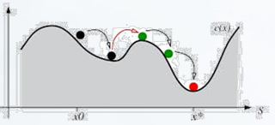
In metallurgy, annealing is the process used to temper or harden metals and glass by heating them to a high temperature and then gradually cooling them, thus allowing the material to reach a lowenergy crystalline state.
To avoid being stuck in a local maxima, it tries randomly
(using a probability function) to move to another state, if this new state is better it moves into it, otherwise try another
move… and so on.
If we just let the ball roll, it will come to rest at a local minimum. If we shake the surface, we can bounce the ball out of the local minimum. The trick is to shake just hard enough to bounce the ball out of local minima but not hard enough to dislodge it from the global minimum.
The simulated-annealing solution is to start by shaking hard (i.e., at a high temperature) and then gradually reduce the intensity of the shaking (i.e., lower the temperature).

Slide 23
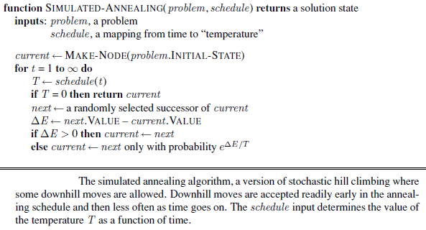

Slide 24
The simulated-annealing algorithm is quite similar to hill climbing. Instead of picking the best move, however, it picks a random move.
If the move improves the situation, it is always accepted. Otherwise, the algorithm accepts the move with some probability less than 1. The probability decreases exponentially with the “badness” of the move—the amount ΔE by which the evaluation is worsened. The probability also decreases as the “temperature” T goes down: “bad” moves are more likely to be allowed at the start when T is high, and they become more unlikely as T decreases. If the schedule lowers T slowly enough, the algorithm will find a global optimum with probability approaching 1.
Simulated annealing was first used extensively to solve VLSI layout problems in the early 1980s. It has been applied widely to factory scheduling and other large-scale optimization tasks.

Slide 25
Local beam search
Keeping just one node in memory might seem to be an extreme reaction to the problem of memory limitations.
The local beam search algorithm keeps track of k states rather than just one.
It begins with k randomly generated states. At each step, all the successors of all k states are generated.
If any one is a goal, the algorithm halts. Otherwise, it selects the k best successors from the complete list and repeats.

Slide 26
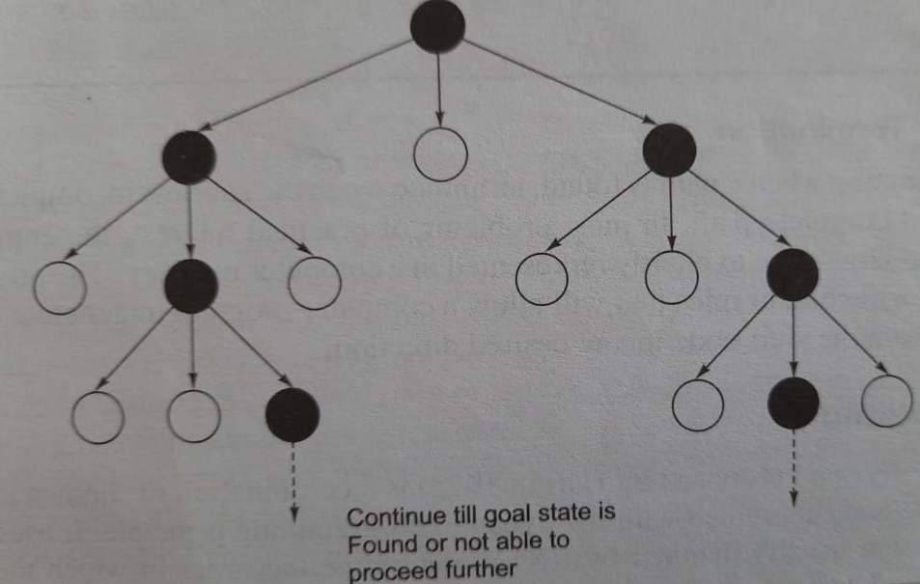

Slide 27
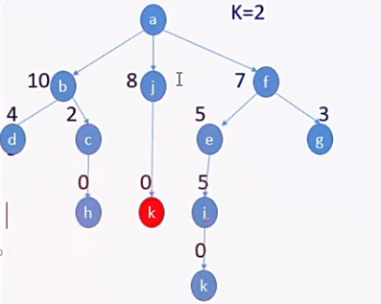

Slide 28
In a local beam search, useful information is passed among the parallel search threads. In effect, the states that generate the best successors say to the others, “Come over here, the grass is greener!” The algorithm quickly abandons unfruitful searches and moves its resources to where the most progress is being made.

Slide 29
In its simplest form, local beam search can suffer from a lack of diversity among thek states—they can quickly become concentrated in a small region of the state space, makingthe search little more than an expensive version of hill climbing. A variant called stochastic beam search , analogous to stochastic hill climbing, helps alleviate this problem.
Instead of choosing the best k from the the pool of candidate successors, stochastic beam search chooses k successors at random, with the probability of choosing a given successor being an increasing function of its value.
Stochastic beam search bears some resemblance to the process of natural selection, whereby the “successors” (offspring) of a “state” (organism)populate the next generation according to its “value” (fitness).

Slide 30
Genetic algorithms
A genetic algorithm (or GA) is a variant of stochastic beam search in which successor states are generated by combining two parent states rather than by modifying a single state.
The analogy to natural selection is the same as in stochastic beam search

Slide 31
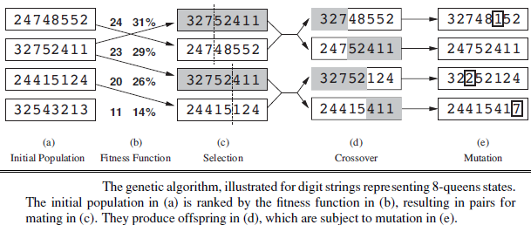
Fitness Function :
Calculate the probability of being regenerated in next generation. For example: 24/(24+23+20+11) = 31% , 23/(24+23+20+11) = 29% , etc.

Slide 32
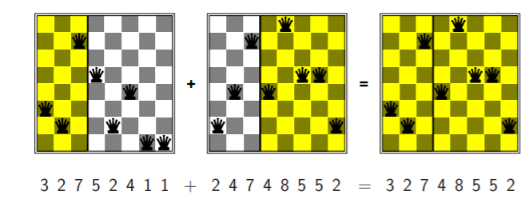

Slide 33
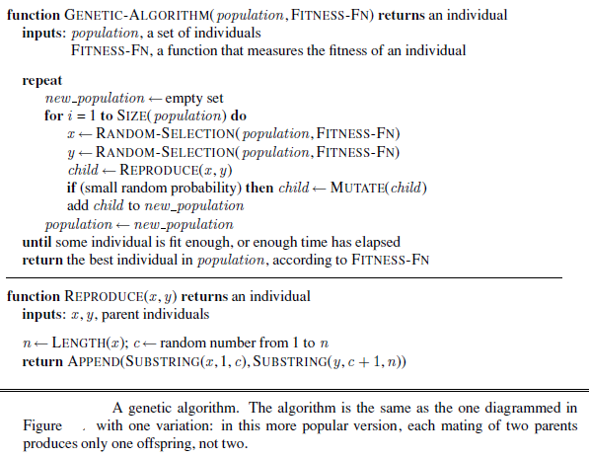

Slide 34
Like beam searches, GAs begin with a set of k randomly generated states, called the population.
Each state, or individual, is represented as a string over a finite alphabet—most commonly, a string of 0s and 1s.
For example, an 8-queens state must specify the positions of 8 queens, each in a column of 8 squares, and so requires 8× log₂ 8=24 bits.
Alternatively, the state could be represented as 8 digits, each in the range from 1 to 8. Figure (a) shows a population of four 8-digit strings representing 8-queens states.
In (b), each state is rated by the objective function, or (in GA terminology) the fitness function. A fitness function should return higher values for better states, so, for the 8-queens problem we use the number of nonattacking pairs of queens, which has a value of 28 for a solution.
The values of the four states are 24, 23, 20, and 11. In this particular variant of the genetic algorithm, the probability of being chosen for reproducing is directly proportional to the fitness score, and the percentages are shown next to the raw scores.

Slide 35
In (c), two pairs are selected at random for reproduction, in accordance with the probabilities in (b).
One individual is selected twice and one not at all.
For each pair to be mated, a crossover point is chosen randomly from the positions in the string.
In Figure the crossover points are after the third digit in the first pair and after the fifth digit in the second pair.
In (d), the offspring themselves are created by crossing over the parent strings at the crossover point. For example, the first child of the first pair gets the first three digits from the first parent and the remaining digits from the second parent, whereas the second child gets the first three digits from the second parent and the rest from the first parent.
The example shows that when two parent states are quite different, the crossover operation can produce a state that is a long way from either parent state. It is often the case that the population is quite diverse early on in the process, so crossover (like simulated annealing) frequently takes large steps in the state space early in the search process and smaller steps later on when most individuals are quite similar

Slide 36
Finally, in (e), each location is subject to random mutation with a small independent probability. One digit was mutated in the first, third, and fourth offspring.
In the 8-queens problem, this corresponds to choosing a queen at random and moving it to a random square in its column.
In practice, genetic algorithms have had a widespread impact on optimization problems, such as circuit layout and job-shop scheduling.

